Slide 1

Indian Trade Analysis and Forecasting
Project Instructor: Dr. Dalia Nandi, Dept. of ECE
Prepared by
Akarsh Somani(39/CSE/16005/0000162)
Gaurav Misra(39/CSE/16015/0000172)

Slide 2
What is Trade?
Trade is an economic concept which involves Buying and Selling of the commodities, or exchanging goods and services between needy people.
Trade is important in a way that it increases competition and decreases overall world wise cost of a product.
India doesn’t produce petroleum products so we import it from Arab countries and export commodities like metals, pearls, clothes and mineral oils to them.
This way countries help each other using trade.

Slide 3
Significance of Analysis and Forecasting
Country Importing more becomes dependent and Country Exporting more becomes economically Stronger.
Trade Analysis provides a raw understanding of how our country’s economy depends on Imported products. So we can distribute our total import into many countries so that no country can control our economy.
Inflation happens when Import increases and our productivity decreases for the particular product.
Knowing Future’s import/export value, we can take precautionary measures for the smooth trading.

Slide 4
About Data
We have taken the data from Department of Commerce, Govt. of India website.
Monthly Trade data is available from January, 2006 to January, 2020 - Country wise and HS code wise.
Trade amount (Import/Export) for each month is expressed in million US dollars.
Harmonized System (HS code) of tariff nomenclature is an internationally standardized system of names and numbers to classify traded products.
Commodity is the description of the Harmonized System items.
e.g.
1 for Live Animal,
95 for Toys, Games and Sports Requisites etc.

Slide 5
Technologies Used
Python3
Libraries used –
Numpy, Matplotlib and Pandas for Basic Data Analysis
Tensorflow, Keras and Scikit-learn for LSTM Implementation
Scikit-learn and Statmodels for other statistical models implementation e.g. ARIMA and Holt winters method.
Jupyter Notebook (IDE For Data Analysis and Visualization)

Slide 6
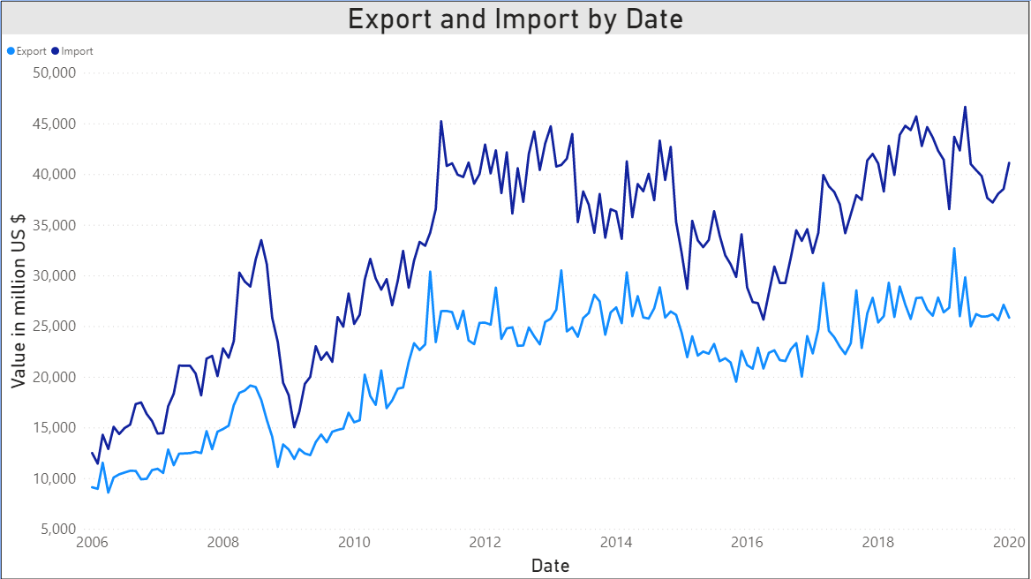
How the Trade Data Looks

Slide 7
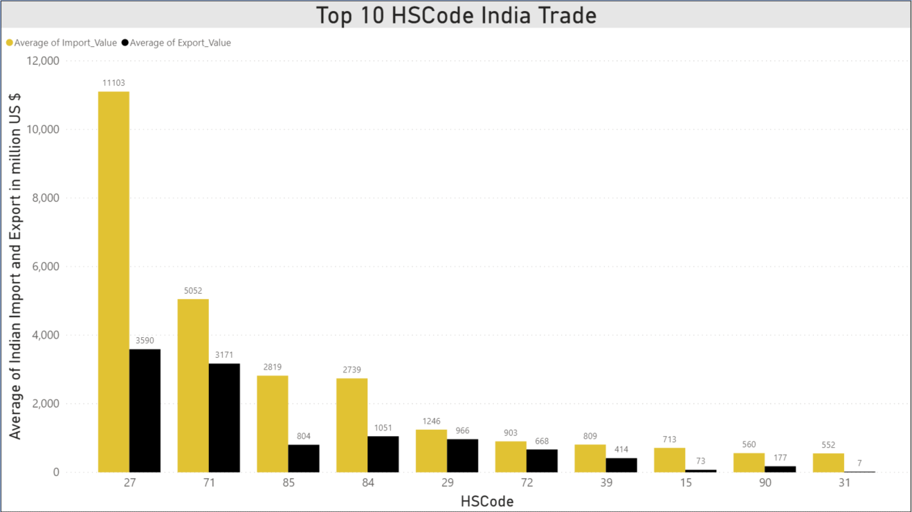
Commodities which India traded the most
27 for Mineral Fuels and Mineral Oils and the product of there distillation.
71 for natural or cultured pearls, precious or semiprecious stones, Pre-Metals, Coins etc.
85 for Electrical Machinery and Equipment

Slide 8
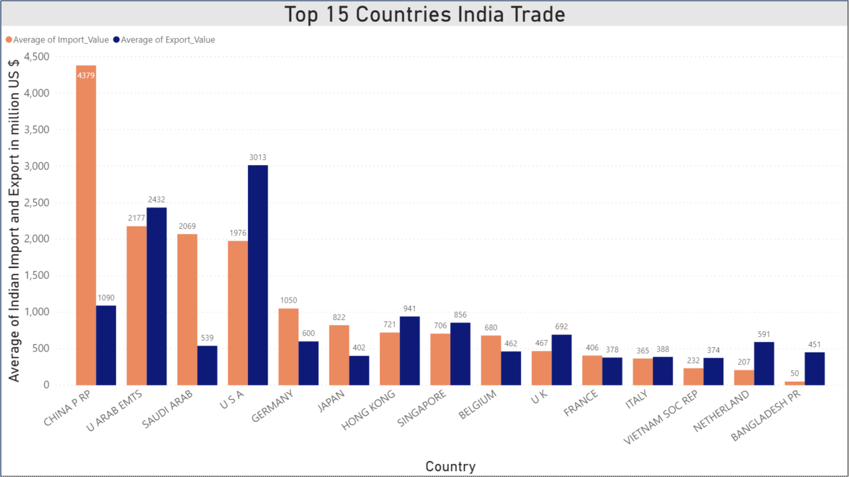
Countries which India traded the most
China tops the list with around $4379 million trade Import followed by United Arab Emirates, Saudi Arab and USA.
While USA is the top country to which India exports the most $3013 million followed by UAE, China, Hong Kong and Singapore.

Slide 9
Models we used for Forecasting
Exponential Smoothing
Auto Regressive Model
Moving Average Model
Holt-Winters Model
ARIMA Additive
ARIMA Multiplicative
ARIMA Seasonal
RNN → LSTM (Long Short Term Memory)

Slide 10
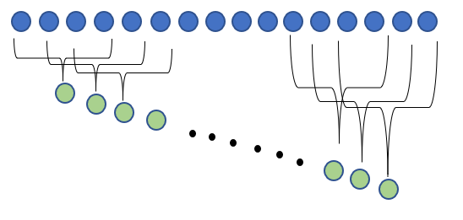
Auto Regressive and Moving Average
AR (Auto Regressive) model is used when a value from the time series has dependency on previous values e.g. X_{t} = f(X_{t-1}). Order of an AR model is the number of immediately preceding values in the series that are used to forecast the current value e.g. order = 2 denotes that X_{t} is dependent on X_{t-1} and X_{t-2}.
MA (Moving Average) is a technique that calculates the overall trend in the dataset. As the name suggest that we take the Average over a fixed rolling size window.

Slide 11
Exponential Smoothing and Holt-Winters
In simple moving average the past observation are equally weighted where as in Exponential Smoothing it exponentially decreases over the time. It has only one smoothing factor.
Holt-Winters is the extension over the simple exponential smoothing method. Here we use triple smoothing with the factor - seasonal period, trend type and seasonal type.

Slide 12
ARIMA – additive and multiplicative
ARIMA stands for Autoregressive Integrated Moving Average which is a combination of three terms –
AR – Auto Regressive
I – Integrated (difference between current values and the previous values)
MA – Moving Average
ARIMA additive –
Additive Time Series = Trend + Seasonality + Randomness
ARIMA multiplicative –
Multiplicative Time Series = Trend * Seasonality * Randomness

Slide 13
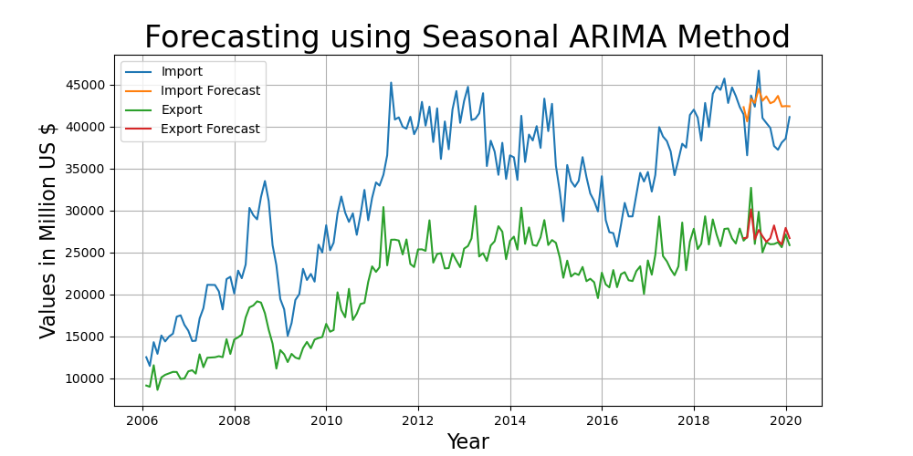
Seasonal ARIMA
Seasonal ARIMA is an ARIMA Multiplicative method with seasonality factor (m). Here we have chosen the multiplicative factor of 12 as ours is a monthly data.

Slide 14
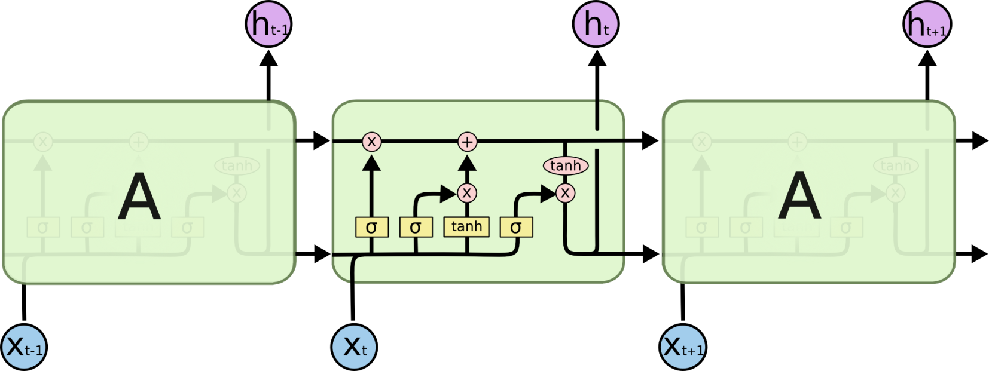
Long Short Term Memory (LSTM)
Recurrent neural networks are used for processing the sequential data, but Unfortunately, as the dependency gets long, RNNs become unable to learn to connect the information.
In these cases, LSTMs come to rescue, which are explicitly designed to avoid the long-term dependency problem.

Slide 15
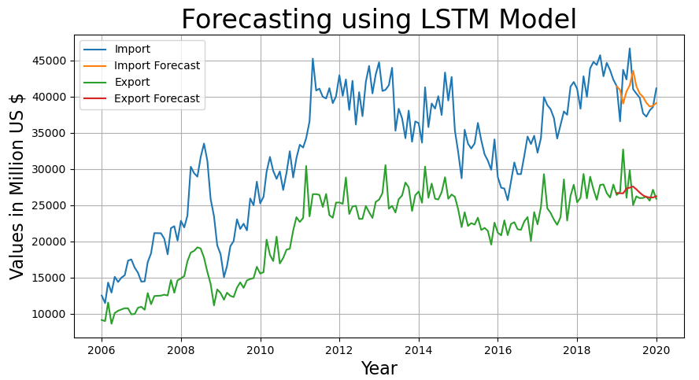
Forecasting using LSTM
We took 12 previous months trade amount as input for our LSTM Model

Slide 16
Comparison of Models
For monthly Import’s data, LSTM stands up to expectations with minimum RMSE of 2637.71
For monthly Export’s data, Seasonal ARIMA outperforms other models with minimum RMSE of 1310.58
Model\Error | Import RMSE | Export RMSE
Exponential Smoothing | 3771.36 | 2042.23
Auto Regressive (AR) model | 2718.07 | 1738.07
Moving Average (MA) model | 7743.73 | 4284.66
Holt-Winters Method | 4417.84 | 1850.49
ARIMA Multiplicative | 3739.46 | 1646.06
ARIMA Additive | 3286.15 | 2026.4
Seasonal ARIMA | 3391.32 | 1310.58
LSTM | 2637.71 | 2043.39

Slide 17
Conclusion
There is an slightly upwards trend in Import forecast and slightly downward trend in the Export forecast.
Seasonal ARIMA Perform better for Forecasting Export Data, which shows that ARIMA captures seasonality much better than any other model, even with lesser data and randomness.
LSTM model performed better for Import Data because of it’s capability of retaining information for long periods of time.
We’re in huge trade deficit (Export-Import) with China in terms of trade. Hence we need to make strict policies towards Chinese products as soon as possible.

Slide 18
Future Prospects
Making Existing Models more robust by tuning them even more.
Using New models specially Attention Models which can even store more information than LSTMs.
Include some factor to encounter the randomness in data which causes high frequency fluctuations which results in under-performance of models.
Getting more data points for better forecasting specially for LSTM model since a neural network needs more and more data for better predictions.

Slide 19
References
Chatfield, C. "The Holt-Winters Forecasting Procedure." ResearchGate, 1978.
Lyashenko, Oksana. "The Application of the ARIMA-models for forecasting the Dynamics of Foreign Trade of Ukraine." ResearchGate, 2020.
Nimisha Tomar, Durga Patel, Akshat Jain. "Air Quality Index Forecasting using Auto-regression Models." ResearchGate, 2020.
S. Vemuri,R. Balasubramanian, E.F. Hill. "Load Forecasting using Moving Average Stochastic Models." ResearchGate, 1974.
Sandip Roy, Sankar Prasad Biswas, Subhajyoti Mahata, Rajesh Bose. "Time Series Forecasting using Exponential Smoothing to Predict the Major Atmospheric Pollutants." ResearchGate, 2018.
Yi-Ting Tsai, Yu-Ren Zeng, Yue-Shan Chang. "Air Pollution Forecasting Using RNN with LSTM." ReasearchGate, 2018

Slide 20
Thank You!

